Slide 1
DreamMachine
BoomBot
Adam Stephenson, David Liang, Nat Mote

Slide 2



Introduce Team
Adam Stephenson
Nat Mote
David Liang

Slide 3

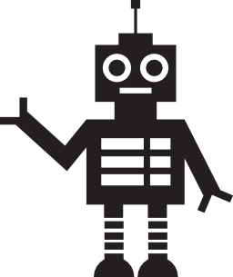


Motivation
Everyone Enjoys Music
Good Speakers Not Portable
Mobility Too Restrictive
Mobile BoomBox

Slide 4



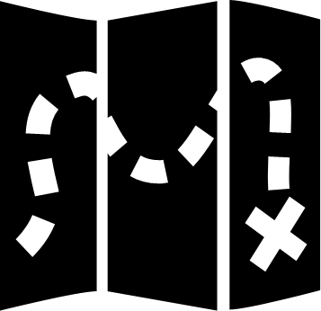

Final Demo Storyboard
Fiesta
?
Location

Slide 5



Technical Challenges
Voice Recognition
Music Player
Difficult Words and Phrases
Tracking and Reporting Metadata
Fiducial Tracking
Web Interface
Plug And Play
Responsive GUI

Slide 6



Evaluation
Tested With Five Users
Responsive To Commands
Easy To Use

Slide 7
Demo

Slide 8

Future Implementation Plans
World Domination
Just Kidding
Not Really…

Slide 9
Questions
?

Slide 10
Thank You!
Hope you enjoyed the presentation!

